Slide 1

Conditional Statements
The "if-else" Statement
if-else
SoftUni Team
Technical Trainers
Software University
https://about.softuni.bg

Slide 2

Table of Contents
Logical Expressions in C#
Comparison Operators: ==, !=, <, >, <=, >=, …
Conditional Statements: if and if-else
Chain of Checks: if-else-if-else-…
Blocks and Variable Scope
Code Debugging and Breakpoints

Slide 3
Have a Question?
sli.do
#prgm-for-qa

Slide 4

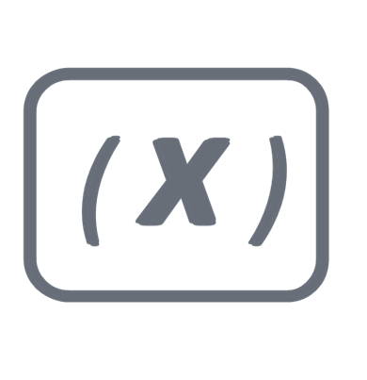

Review
Variables, Data Types, Expressions and Statements
(a+b) *c - 1
10110

Slide 5
Variables
Variables hold data of certain type and allow:
Storing data in named memory location
Retrieving the stored data
Modifying the stored data
Declaring, initializing, reading and changing a variable:
int age = 5;
age = age + 1;
Console.WriteLine(age);

Slide 6
Data Types
Data types define ranges / domains of values
Integer number – int (e. g. 5, 0, 120, -250)
Floating-point number – double (e. g. 3.14159, 0.5)
Boolean (true / false) – boolean (true or false)
Unicode characters (letters) – char (e. g. 'X', '#', '\n')
Unicode strings (text) – String (e. g. "Hello Java")
Date / date and time, e. g. 24-May-2019 11:38
Complex data types, e. g. arrays, lists, maps, classes

Slide 7
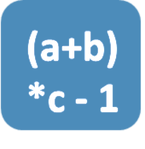
Expressions
Expressions == variables and values, combined with operators
2 is a literal value expression
b * 2 + 1 is an arithmetic expression
a = b * 2 + 1;
b is a variable expression
a = b * 2 + 1 is an assignment expression

Slide 8

Statements
Statements == commands / actions to be executed
Multiply that value by 2
Get the current value stored in b
Store the result back into another variable called a
a = b * 2;
Console.WriteLine(a*2);
Method call statement

Slide 9
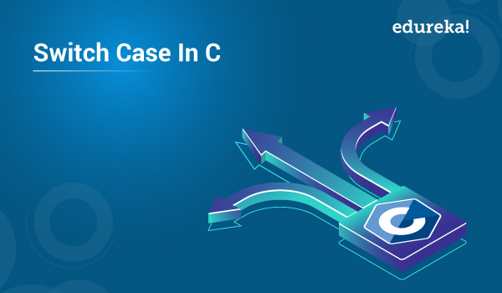
Conditional Statements in the Real Life

Slide 10

Real Life Example: Watering Plants
If it is raining:
I shall skip watering the plants in the garden
Else:
I will have to water them
if (humidity > 90%)
Console.WriteLine("Rain -> skip watering");
else
Console.WriteLine("No rain -> water the plants");

Slide 11
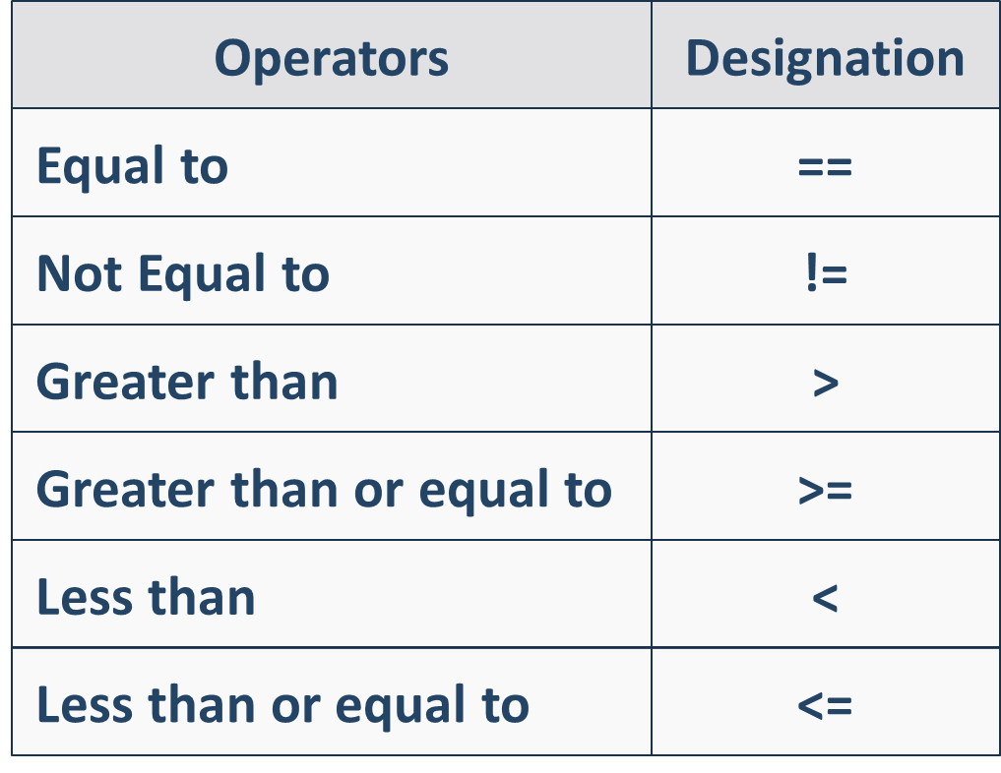
==
Logical Expressions
Comparison Operators

Slide 12
Comparison Operators
Operators
Designation
Equal to
==
Not Equal to
!=
Greater than
>
Greater than or equal to
>=
Less than
<
Less than or equal to
<=

Slide 13
Value Comparison
In programming we can compare values (e.g. numbers)
The result of the logical expressions is either true or false
int a = 5;
int b = 10;
str = "hi";
Console.WriteLine(a < b); // true
Console.WriteLine(a > 100); // false
Console.WriteLine(a <= 5); // true
Console.WriteLine(b == 2 * a); // true
Console.WriteLine(b != 2 * a); // false
Console.WriteLine(str == "hi"); // true

Slide 14

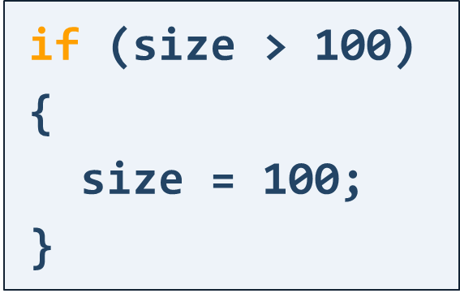
Conditional Statements
Simple Conditions

Slide 15
Simple Conditions
Check a condition and act according to the result
The result is either true or false
The code block { } may hold one or multiple commands
if (condition)
{
// Code to execute when // the condition is true
}
int size = …;
if (size > 100)
{
size = 100;
}
Boolean expression

Slide 16

Problem: Freezing Weather
Write a program to check for freezing water, which:
Reads a temperature in Celsius
Checks whether the temperature is below zero
Prints "Freezing weather!", if the temperature is equal or smaller than 0, otherwise print nothing
4
(no output)
-2
Freezing weather!

Slide 17
Solution: Freezing Weather
double temperature =
double.Parse(Console.ReadLine());
if (temperature < 0)
{
Console.WriteLine("Freezing weather!");
}

Slide 18
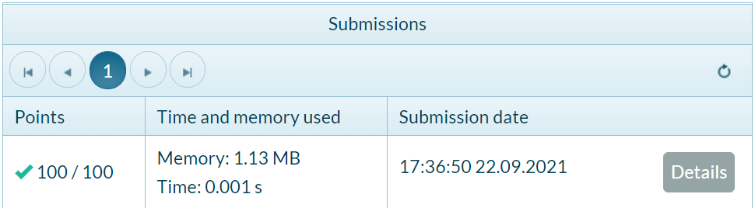
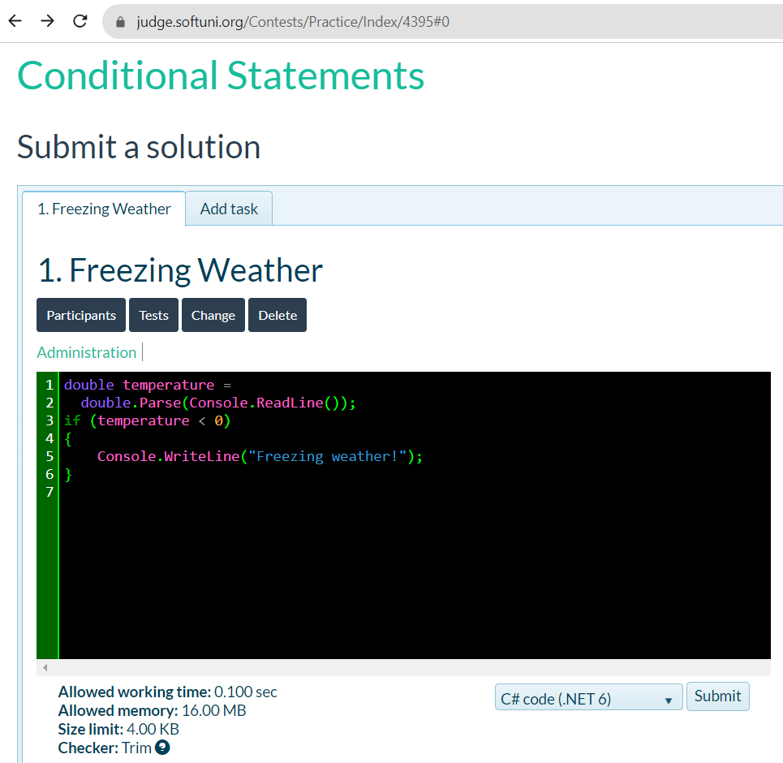
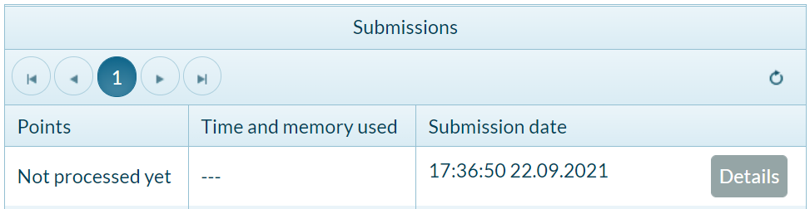
Submission in the Judge System
https://judge.softuni.org/Contests/Practice/Index/4395

Slide 19
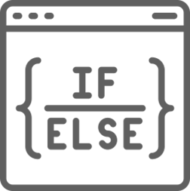
Simple Conditions: if-else
If the condition is false, we may execute another code, using the statement еlse
if (condition)
{
// Condition is true
}
else
{
// Condition is false
}

Slide 20
Blocks of Code: { … }
string color = "red";
if (color == "red")
{
Console.WriteLine("tomato");
Console.WriteLine("strawberry");
}
else
{
Console.WriteLine("banana");
Console.WriteLine("lemon");
Console.WriteLine("pear");
}
Block of 2 commands
Block of 3 commands

Slide 21
Single Line Statements
The curly brackets {} introduce a block (a group of commands)
In case the if statement does not have curly brackets, only the code on the next line will be executed
string color = "red";
if (color == "red")
Console.WriteLine("tomato");
else
Console.WriteLine("banana");
Console.WriteLine("lemon");
Single line statement
Single line statement
Always executed

Slide 22
Problem: Even or Odd
Write a program to check for odd / even number, which:
Reads an integer
If it's even, prints "even"
If it's odd, prints "odd"
4
even
7
odd

Slide 23
Solution: Even or Odd
int num = int.Parse(Console.ReadLine());
if (num % 2 == 0)
{
Console.WriteLine("even");
}
else
{
Console.WriteLine("odd");
}
https://judge.softuni.org/Contests/Practice/Index/4395

Slide 24
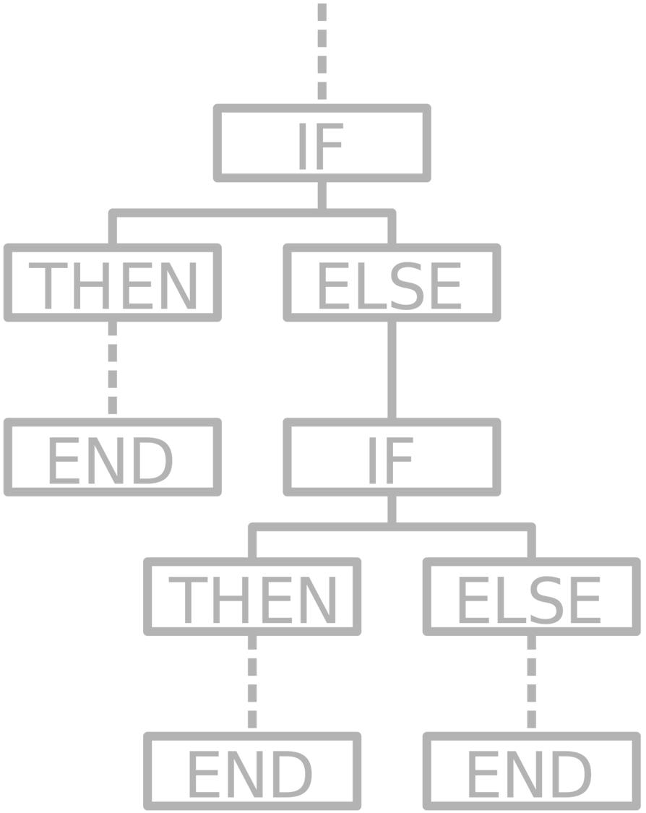
Chain of Checks
Sequences of if-else-if-… Conditional Statements

Slide 25
Chain of Checks
The if-else statement can be in a series
if (…)
// Some code
else if (…)
// Other code
else if (…)
// Another code
else
// Last code
If one condition is true, the program will NOT check the rest of the conditions

Slide 26
Chain of Conditions – Example
The program checks the first condition, finds that it is true and ends
The output is just "Bigger than 4"
int a = 7;
if (a > 4)
Console.WriteLine("Bigger than 4");
else if (a > 5)
Console.WriteLine("Bigger than 5");
else
Console.WriteLine("Equal to 7");

Slide 27
Problem: Number 1…9 as Words
Write a program to print a number as words, which:
Reads an integer and checks its value [1 … 9]
Prints the value in the form of English words
If the number is out of range, prints "Out of range"
7
seven
10
Out of range
2
two

Slide 28
Solution: Number 1…9 as Words
int num = int.Parse(Console.ReadLine());
if (num == 1)
Console.WriteLine("one");
else if (num == 2)
Console.WriteLine("two");
else if (…) …
// TODO: Add the rest of the conditions
else
Console.WriteLine("Out of range");
https://judge.softuni.org/Contests/Practice/Index/4395

Slide 29

Variable Scope
Range of Use for the Variables

Slide 30
Variable Scope
Variable scope == the range of lines, in which it can be used:
string currentDay = "Monday";
if (currentDay == "Monday")
{
double salary = double.Parse(Console.ReadLine());
}
Console.WriteLine(salary); // Compile-time error!
The variable salary exists only in the block of code of the if statement

Slide 31

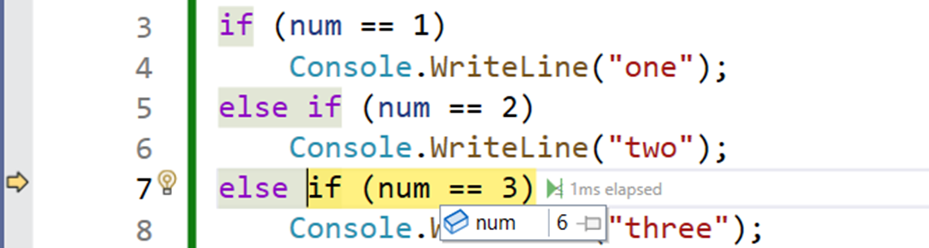
Debugging
Operations with the Debugger

Slide 32
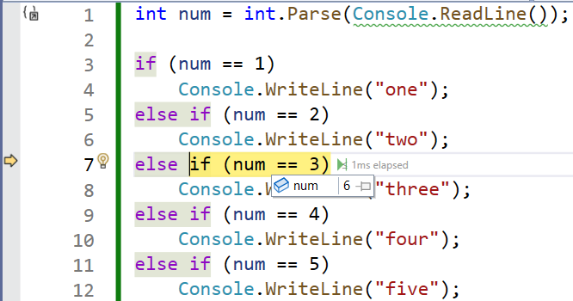
Debugging
The process of tracing the code execution
Debugging allows finding defects (bugs)

Slide 33
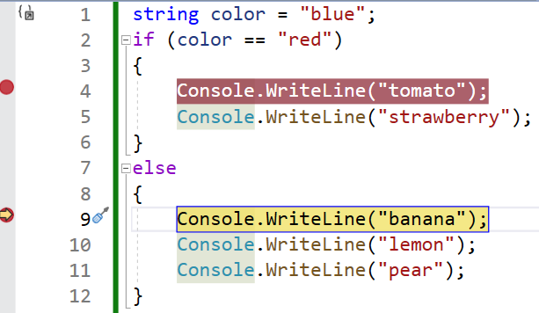
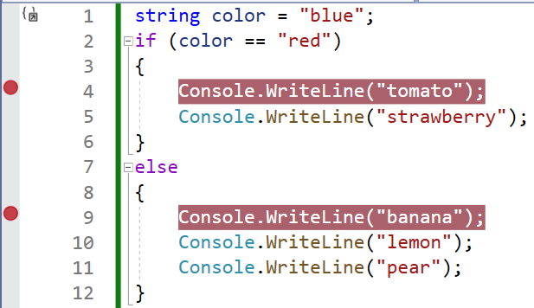
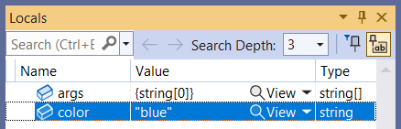
Debugging in Visual Studio
Start the program in debug mode: press [F5]
Go to the next step: press [F10]
Аdd / remove breakpoint: press [F9]

Slide 34

Summary: Conditional Statements
…
…
…
Logical Expressions
Comparison Operators: <, >, ==, !=, …
Conditional Statements (if and if-else)
Chain of if-else-if-else Checks
Blocks and Variable Scope
Debugging and Breakpoints

Slide 35

Questions?

Slide 36













SoftUni Diamond Partners

Slide 37
Trainings @ Software University (SoftUni)
Software University – High-Quality Education, Profession and Job for Software Developers
softuni.bg, about.softuni.bg
Software University Foundation
softuni.foundation
Software University @ Facebook
facebook.com/SoftwareUniversity
Software University Forums
forum.softuni.bg
37
Notes:
37

Slide 38

License
This course (slides, examples, demos, exercises, homework, documents, videos and other assets) is copyrighted content
Unauthorized copy, reproduction or use is illegal
© SoftUni – https://about.softuni.bg
© Software University – https://softuni.bg
Notes:
38

